Slide 1
MIMO techniques in 5G/6G
Ian Cho ic404
Supervised by: Prof. Albert Guillen I Fabregas, Alexander Hamilton (Nokia)

Slide 2
What is 5G?
5G delivers faster speeds(Gb/s), ultra-low latency(~1ms) and massive connectivity.
LTE (Long-Term Evolution)
Orthogonal Frequency-Division Multiplexing (OFDM)
Multi Input Multi Output (MIMO)
NR (New Radio)
Flexible subcarrier spacing
Sub-6 GHz to mm waves
Massive MIMO and Beamforming

Slide 3
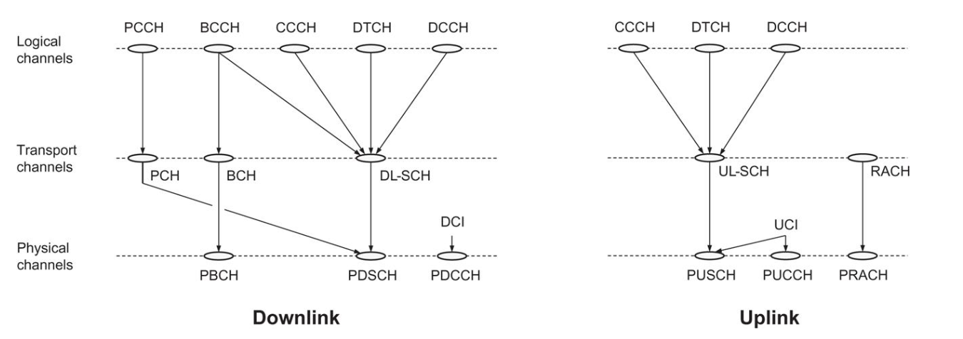
Physical Layer Overview
Figure from E. Dahlman, 2018, 5G NR: The Next Generation Wireless Access Technology, Chapter 6

Slide 4
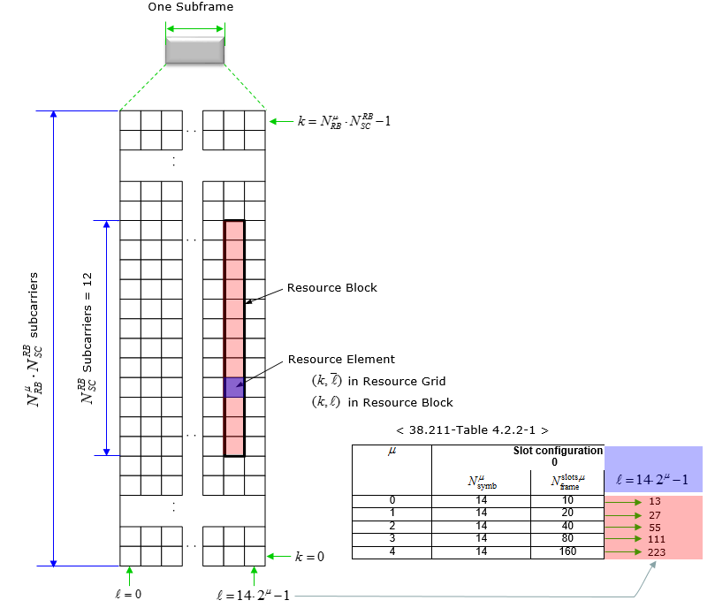
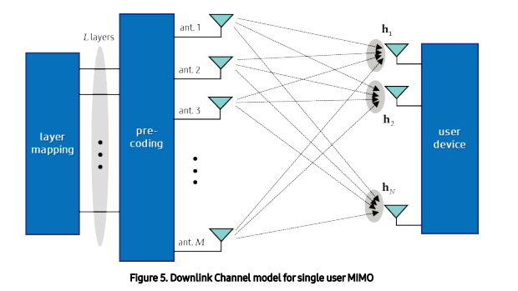
What is MIMO?
MIMO (Multi-Input Multi-Output) makes use of multiple antennas to transmit and receive parallel data streams
Figures from https://sharetechnote.com

Slide 5
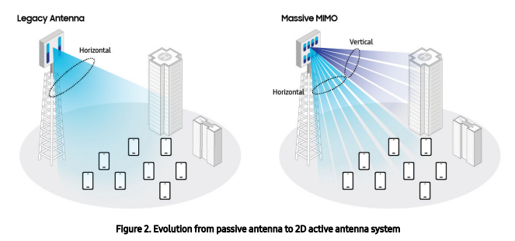
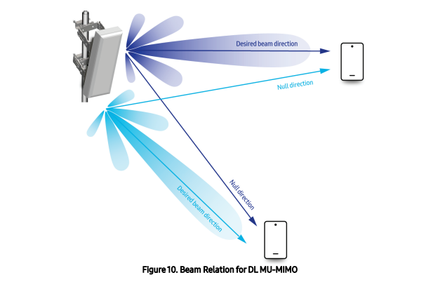
Massive MIMO and Beamforming
Legacy Antennas vs. Massive MIMO
Beamforming and Multi-User (MU)-MIMO
Figures from Samsung Technical White Paper, 2020, Massive MIMO for New Radio

Slide 6
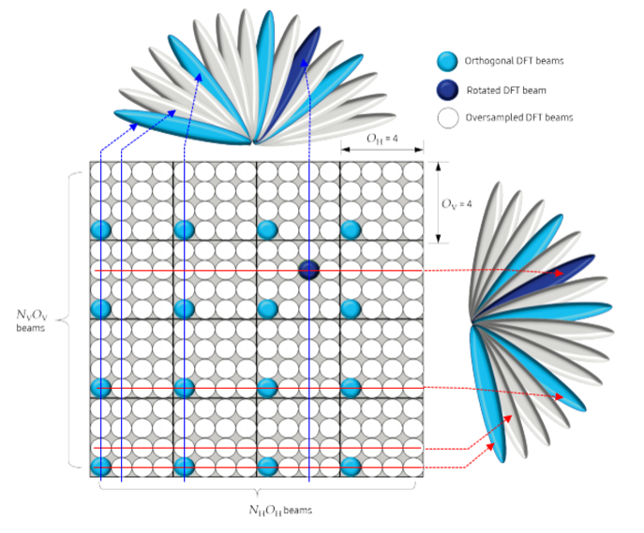
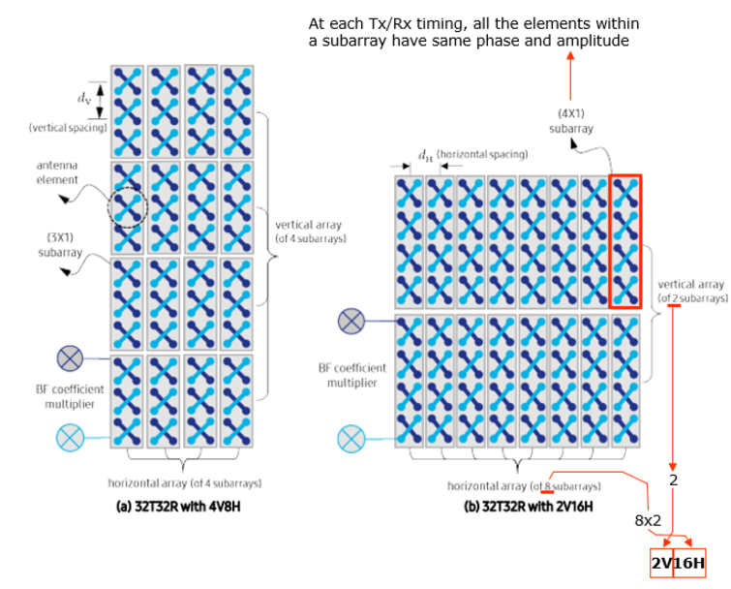
Beamforming Process
Figures from Samsung Technical White Paper, 2020, Massive MIMO for New Radio

Slide 7
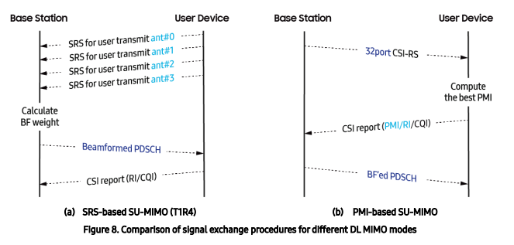
Channel Estimation
Process where reference signals allow UE to evaluate channel conditions for optimising beamforming and DL transmissions.
Sounding Reference Signal (SRS)
Precoding Matrix Indicator (PMI)
Channel State Information (CSI)
Channel Quality Index (CQI) and Ranking Indicator (RI)
Feature | SRS-Based MIMO | PMI-Based MIMO
Channel Accuracy | High | Moderate
Processing Complexity | High(Base Station) | Low(UE)
Frequency selectivity | Well-Suited | Limited
Adaptation to Fast Changes | High | Low
Resource Usage | High Uplink Usage | Low Uplink Usage
Figure from Samsung Technical White Paper, 2020, Massive MIMO for New Radio

Slide 8
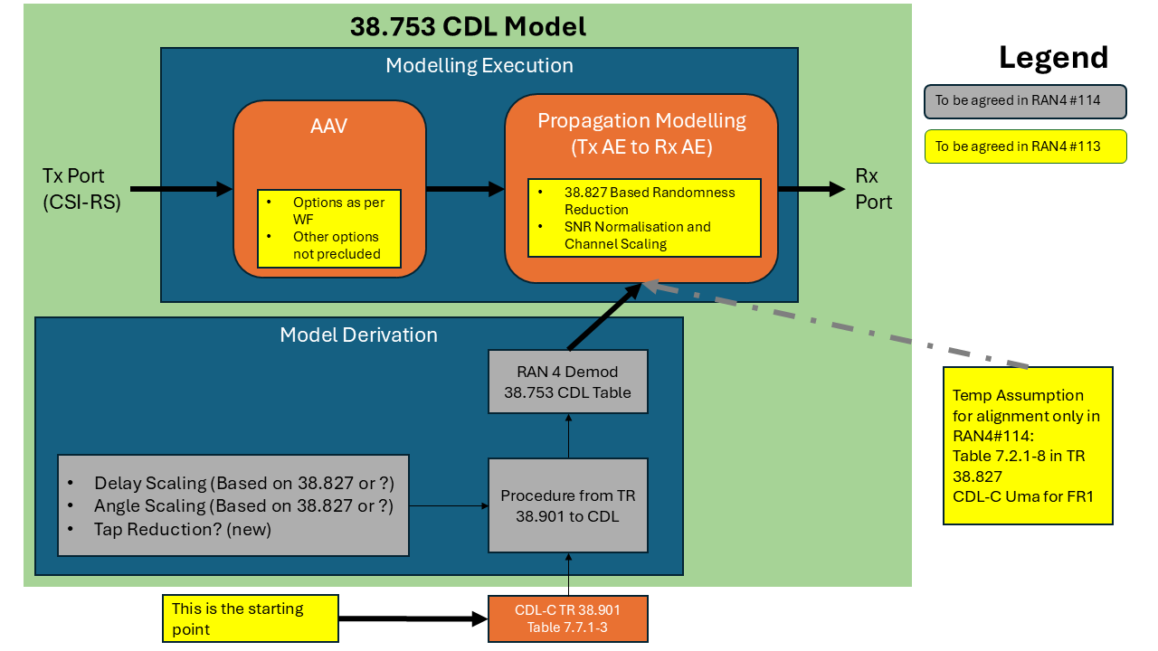
Channel Modelling
Tapped Delay Lines (TDL)
Individual taps for discrete delays
Basic channel fading (Rayleigh, Rician)
Low complexity
Lacks spacial and angular precision
Clustered Delay Lines (CDL)
Clusters of taps representing ground paths
Detailed spatial and angular modelling
High complexity
Advanced propagation characteristics (angular speed, Dopper shifts, spacial correlation)
Allows for Massive MIMO and Beamforming
System Diagram of CDL model version 38.753 (Under Development) from 3GPP

Slide 9
Project Direction
Aims
Simulate propagation models for both TDLs and CDLs
Measure performance index based on spectral efficiency and coverage
Vary antennae array configurations and analyse
Array size/Number of Arrays/Subarray size/Angle of Propagation
Expected Outcomes
Deeper insights into TDL vs. CDL model behaviour
Optimisation for antenna configurations

